Slide 1
Module 2: Enhancing Concussion Reporting
Developed by:
William Ernst, Psy.D.
Associate Professor of Psychology
Executive Director, Center for Concussion Education and Research
Chestnut Hill College
Meredith Kneavel, Ph.D.
Professor of Psychology
Director of Research and Assessment, Center for Concussion Education and Research
Chestnut Hill College
Lynn Brandsma, Ph.D.
Associate Professor of Psychology
Chestnut Hill College
Brendan Connell, M.S, LAT, ATC
Assistant Athletic Trainer
Chestnut Hill College

Slide 2
    Cognitive-Behavioral Model of Change
      Primary Concept: Cognitions are major determinants of emotions and behaviors.
        Cognition/Thought = “What if I ask him/her to go out on a date and he/she says no?”
        Emotional state: Anxious
        Behavior: Avoid asking the person out on date.
      Schemas are thought patterns that are involved in information processing, develop over time and are likely to be influenced by genetics, temperament and environmental experiences. Schema’s shape cognitions (how we think about things).

Slide 3
Cognitive-Behavioral Model of Behavior Change
      Question: What step or link in the chain do you think interventions are primarily targeted in the Cognitive-Behavioral Model of change?
      Answer: Cognitions/Thoughts
      Question: What would be an example of an intervention/replacement thought targeting the cognition: “What if I ask him/her to go out on a date and he/she says no?”
      Answer: “What is the worst thing that can happen if he/she says no?”
        Modifying the cognition as described above is likely to decrease anxiety and increase the likelihood that the individual will ask the person out on a date.

Slide 4
Using the Cognitive-Behavioral Model of Change to Enhance Self-Reporting of Concussion
Step 1: Identify cognitions that impede concussion reporting such as:
  “If I report my concussion, I will let my team down because I will not be allowed to play.”
Step 2: Replace or modify the cognition identified in Step 1 with one that will facilitate reporting such as:
  “If I report my concussion, not only will I be protecting my brain, but I will most likely be able to return to play when I am 100%, which will be more helpful to my team.”

Slide 5
Activity 1: Enhancing Self-Reporting of Concussion
In this activity, each person will generate cognitions that might impede reporting their concussions.
Step 1: On the orange paper, list in the first column a thought you have had in the past or could imagine having that might prevent you from reporting a concussion.
Step 2: In the second column, write a replacement cognition that is likely to increase reporting.
Fill in as many as you can think of
*See next slide for an example

Slide 6
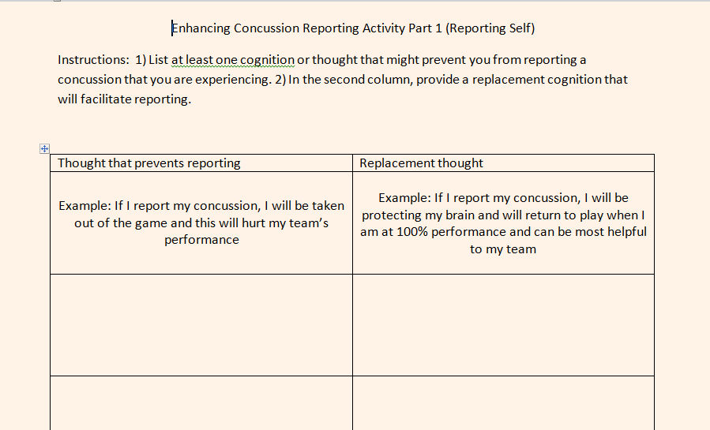

Slide 7
Using the Cognitive-Behavioral Model of Change to Enhance Reporting of Suspected Concussion in Teammates
Step 1: Identify cognitions that impede reporting teammates such as:
  It is not my responsibility to report my teammate, if they want to play with a concussion, that is their choice.
Step 2: Replace or modify the cognition identified in Step 1 with one that will facilitate reporting such as:
  It is my responsibility as a teammate to look after the safety of everyone on my team by reporting suspected concussions and other concerns to the trainer.

Slide 8
Activity 2: Enhancing Reporting of Teammates with Suspected Concussion
In this activity each person will generate cognitions that might impede reporting teammates who you suspect has a concussion.
Step 1: On the green paper in your folder, list in the first column a thought that might prevent you from reporting a suspected concussion in a teammate.
Step 2: In the second column, write a replacement cognition that is likely to increase reporting.
Fill in as many as you can think of
*See next slide for example

Slide 9
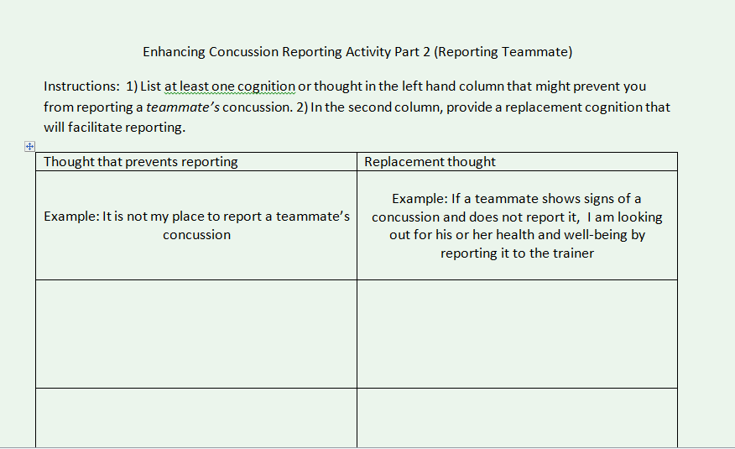

Slide 10


