Slide 1
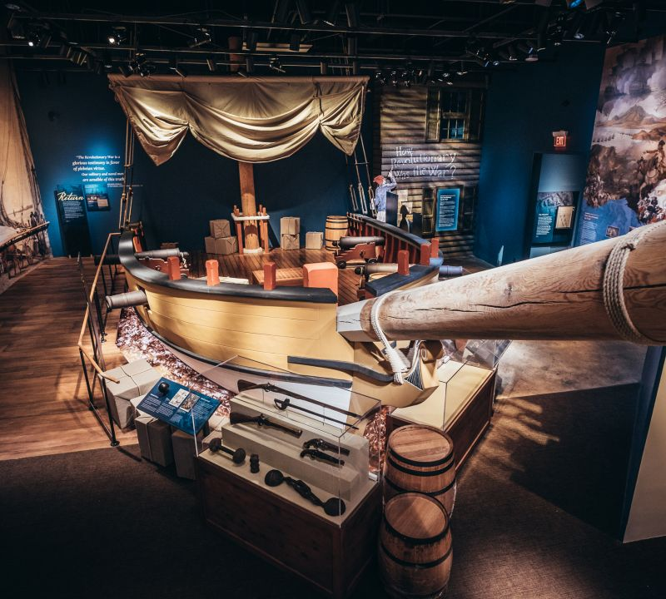
The History Club Presents… Museum of the American Revolution Trip Date: Saturday, November 16 Time: 9:40AM to 2PM Transportation to and from the Museum is provided Sign-up in the Student Activities Office; $5 required
Accommodation requests and/or physical access needs related to a disability should be made by
November 8 to the History Department's Dr. Lorraine Coons at 215-248-7184 or lcoons@chc.edu

