Slide 1
The Basics of MLA Formatting

Slide 2
General Format
Your essay should include two major sections:
2. Works Cited Page
1. Main Body
MLA papers do not have title pages. The title and author’s information are included on the first page of the main body.
Notes:
It is important to remind students that each page should have a page header with a short title and page number.
This slide can be supplemented by the “General Format” section from OWL http://owl.english.purdue.edu/owl/resource/560/01/

Slide 3
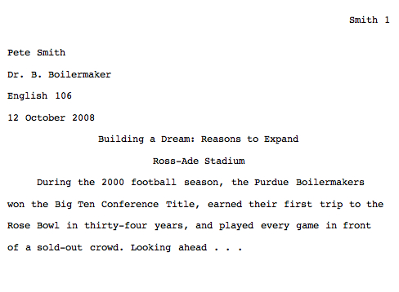
Formatting the First Page
1. Your name
Header= your last name and the page number
2. Your professor’s name
3. Name of class
Title of the paper
4. Date
The title should not be underline or boldfaced

Slide 4
In-Text Citations
Used to cite information that you have taken from another source and used in your paper in the form of:
Direct Quotes
Paraphrasing
Summary
Whenever you use a source, provide in parenthesis:
the author’s last name and the page number where the information is found

Slide 5
In-text Citations: Formatting Quotations
With a signal phrase
Human beings have been described by Kenneth Burke as “symbol-using animals” (3).
Without a signal phrase
Human beings have been described as “symbol-using animals” (Burke 3).

Slide 6
In-text Citations: Formatting a Summary or Paraphrase
With a signal phrase
Legal scholar Jay Kesan points out that the law holds employers liable for employee’s actions such as violations of copyright laws, the distribution of offensive material, and illegal disclosure of confidential information (312).
The law holds employers liable for employee’s actions such as violations of copyright laws, the distribution of offensive material, and illegal disclosure of confidential information (Kesan 312).
Without a signal phrase
Notes:
This slide can be supplemented by the “Quoting, Paraphrasing, and Summarizing” section from OWL
http://owl.english.purdue.edu/owl/resource/563/01/
and sections on APA in-text citations:
http://owl.english.purdue.edu/owl/resource/560/01/
http://owl.english.purdue.edu/owl/resource/560/02/

Slide 7
In-text Citations: A Work with Two or Three Authors
Smith, Yang, and Moore argue that tougher gun control is not needed in the United States because it erodes Second Amendment rights (76).
With a signal phrase
For a source with three or fewer authors, list the authors' last names in the text or in the parenthetical citation
Some legal experts argue that tougher gun control is not needed in the United States because it erodes Second Amendment rights (Smith, Yang, and Moore 76).
Without a signal phrase

Slide 8
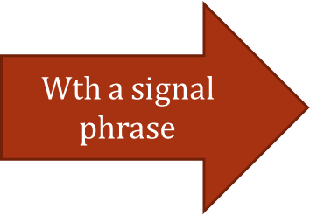
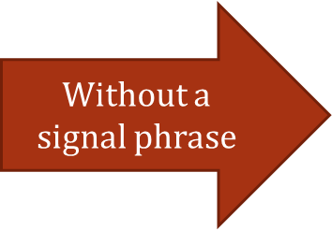
In-text Citations: A Work with Four or More Authors
When citing a work with four or more authors, identify the first author’s name followed by “et al.”
Jones et al. counter Smith, Yang, and Moore's argument by noting that the current spike in gun violence in America compels law makers to adjust gun laws (4).
Some legal experts counter Smith, Yang, and Moore's argument by noting that the current spike in gun violence in America compels law makers to adjust gun laws (Jones et al. 4).
OR…

Slide 9
In-text Citations: Selection in an Anthology
Put the name of the author of the selection (not editor of the anthology) in the signal phrase or the parenthesis.
In “Love is a Fallacy,” the narrator’s logical teachings disintegrate when Polly declares that she should date Petey because, “he’s got a raccoon cost” (Shulman 379).
Notes:
This slide explains and exemplifies the specific cases of in-text citations. It might be supplemented with “Author/Authors” section from OWL http://owl.english.purdue.edu/owl/resource/560/03/

Slide 10
In-text Citations: Verse Play or Poem
For verse plays, give act, scene, and line numbers that can be located in any edition of the work. Separate the numbers with periods.
In Shakespeare’s King Lear, Gloucester, blinded for suspected treason, learns a profound lesson from his tragic experience: “A man may see how this world goes / with no eyes” (4.2.148-49).

Slide 11
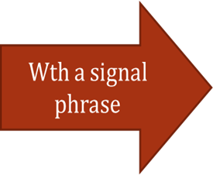
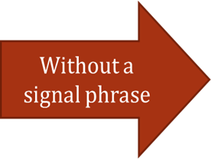
In-text Citations: A Work of Unknown Author
When a source has no known author, use a shortened title of the work instead of an author name, and provide a page number. Titles of books are italicized; titles of articles are put in quotation marks.
According to the article “Impact of Global Warming,” we see so many global warming hotspots in North America likely because this region has "more readily accessible climatic data and more comprehensive programs to monitor and study environmental change . . ." (6).
We see so many global warming hotspots in North America likely because this region has "more readily accessible climatic data and more comprehensive programs to monitor and study environmental change . . ." ("Impact of Global Warming" 6).
Notes:
This slide explains and exemplifies the specific cases of in-text citations. It might be supplemented with “Author/Authors” section from OWL http://owl.english.purdue.edu/owl/resource/560/03/

Slide 12
In-text Citations: Work with no Page Numbers
Do not include a page number if the work lacks page numbers, as is the case with many Web sources.
As a 2005 study by Salary.com and America Online indicates, the Internet ranked as the top choice among employees for ways of wasting tome on the job; it beat talking with co-workers by a margin of nearly two to one (Frauenheim).

Slide 13
Works Cited Page
Center the title (Work Cited) at the top of the page. Do not bold or underline it.
Double-space reference entries
Flush left the first line of the entry and indent subsequent lines
Order entries alphabetically by the author’s last name

Slide 14
Works Cited: Basics
Invert authors’ names
last name first followed by the first name:
Alphabetize reference list entries by the last name of the first author of each work
In titles of works, capitalize all words except articles (a, an, the), prepositions (into, between, etc.), coordination conjunctions (and, but, or, nor, for, so, yet), and the to infinitives
Italicize titles of longer works such as books; use quotation marks for titles of articles and other short works
Smith, Jane.

Slide 15
Works Cited: Basics
The general pieces of information that MLA suggests including in each Works Cited entry should be listed in the following order:
Author.
Title of Source.
Title of Container,
Other Contributors,
Version/Edition,
Volume/Issue Number(s),
Publisher,
Publication Date,
Location/page numbers.
*Not all citations will include all 9 of these elements. What you include will vary depending on the source.*

Slide 16
Works Cited: Basic Format for Books
Lastname, Firstname. Title of Book. Publisher, publication date.
Ex.:
Henley, Patricia. The Hummingbird House. MacMurray, 1999.

Slide 17
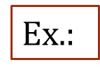
Work Cited: Work with Two or Three Authors
Lastname, Firstname, and Firstname Lastname. Title of Book. Publisher, publication date.
Gillespie, Paula, and Neal Lerner. The Allyn and Bacon Guide to Peer Tutoring. Allyn and Bacon, 2000.

Slide 18
Works Cited: A Selection from an Anthology
Last name, First name. "Title of Essay." Title of Collection, edited by Editor's Name(s), Publisher, Year, Page range of entry.
Harris, Muriel. "Talk to Me: Engaging Reluctant Writers." A Tutor's Guide: Helping Writers One to One, edited by Ben Rafoth, Heinemann, 2000, pp. 24-34.

Slide 19
Works Cited: Basics for Online/Electronic Sources
Here are some common features you should try to find before citing electronic sources in MLA style:
Author and/or editor names (if available)
Article name in quotation marks.
Title of the website, project, or book in italics.
Any version numbers available, including editions (ed.), revisions, posting dates, volumes (vol.), or issue numbers (no.).
Publisher information, including the publisher name and publishing date.
Take note of any page numbers (p. or pp.) or paragraph numbers (par. or pars.).
URL (without the https://) DOI or permalink.
Date you accessed the material (Date Accessed)—While not required, it is highly recommended, especially when dealing with pages that change frequently or do not have a visible copyright date.
Remember to cite containers after your regular citation. Examples of containers are collections of short stories or poems, a television series, or even a website. A container is anything that is a part of a larger body of works.

Slide 20
Work Cited: Work from an Online Database
Lastname, Firstname. “Title of Article.” Journal Title, Vol.#, no. #, year of publication, page range. Database Name. DOI or URL. Date of Access.
Langhamer, Claire. “Love and Courtship in Mid Twentieth-Century England.” Historical Journal, vol. 50, no. 1, 2007, pp. 173- 96. ProQuest, doi:10.1017/S0018246X06005966. Accessed 27 May 2009.

Slide 21
Works Cited: A Page on Website
Editor or Author(if available). “Title of the Page.” Name of Website. The sponser/publisher of the site, date of resource creation (if available), DOI, URL, or permalink. Date accessed(if available).
Lundman, Susan. "How to Make Vegetarian Chili." eHow, www.ehow.com/how_10727_make-vegetarian-chili.html. Accessed 6 July 2015.
Without author:
"Athlete's Foot - Topic Overview." WebMD, 25 Sept. 2014, www.webmd.com/skin-problems-and-treatments/tc/athletes- foot-topic-overview.

Slide 22
Works Cited: An Image Accessed Online (painting, sculpture, or photograph)
You may have to hunt around to find the information; don't be lazy!
Try to find as much of the following information as possible:
Lastname, Firstname. Title of Artist’s Work, Title of Website, date published/posted, URL, Date accessed.
Adams, Clifton R. “People relax beside a swimming pool at a country estate near Phoenix, Arizona, 1928.” Found, National Geographic Creative, 2 June 2016, natgeofound.tumblr.com/. Accessed May 2006.

Slide 23
Helpful Websites
For more information on formatting your paper visit:
The CHC Writing Center’s website at: www.chc.edu/writingcenter/
The Purdue Online Writing Lab (Purdue OWL) at: http://owl.english.purdue.edu/owl
Easybib Overview of MLA 8
http://www.easybib.com/guides/citation-guides/mla-format/

