Slide 1
The Basics of APA Formatting

Slide 2
General Format
Your essay should include four major sections:
4. References
3. Main Body
2. Abstract
1. Title page
Notes:
It is important to remind students that each page should have a page header with a short title and page number.
This slide can be supplemented by the “General Format” section from OWL http://owl.english.purdue.edu/owl/resource/560/01/

Slide 3
Formatting the Title Page
page number
Title of the paper *BOLDED*
Your name
Affiliation
Course
Instructor
Due date
*The title should not exceed one line. If it does, use a shortened version of your title

Slide 4
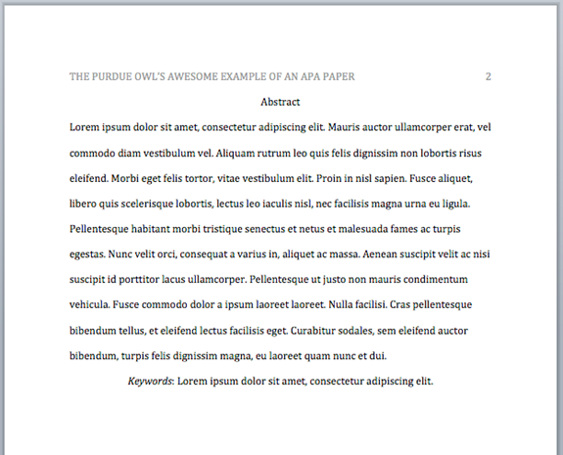
The Abstract
The second page of your paper
Summarizes your subject, research method, findings, and conclusions
Abstract should be centered and bolded.

Slide 5
In-Text Citations
Used to cite information that you have taken from another source and used in your paper in the form of:
Direct Quotes
Paraphrasing
Summary
Whenever you use a source, provide in parenthesis:
the author’s name and the date of publication
for quotations and close paraphrases, provide the author’s name, date of publication, and a page number

Slide 6
In-text Citations: Formatting Quotations
With a signal phrase
Caruth (1996) states that a traumatic response frequently entails a “delayed, uncontrolled repetitive appearance of hallucinations and other intrusive phenomena” (p. 11).
Without a signal phrase
A traumatic response frequently entails a “delayed, uncontrolled repetitive appearance of hallucinations and other intrusive phenomena” (Caruth, 1996, p. 11).

Slide 7
In-text Citations: Formatting a Summary or Paraphrase
With a signal phrase
Smith (2002) explained that sibutramine suppresses appetite by blocking the reuptake if the neurotransmitters serotonin and norepinephrine in the brain (p. 594).
Sibutramine suppresses appetite by blocking the reuptake of the neurotransmitters serotonin and norepinephrine in the brain (Smith, 2002, p. 594).
Without a signal phrase
Notes:
This slide can be supplemented by the “Quoting, Paraphrasing, and Summarizing” section from OWL
http://owl.english.purdue.edu/owl/resource/563/01/
and sections on APA in-text citations:
http://owl.english.purdue.edu/owl/resource/560/01/
http://owl.english.purdue.edu/owl/resource/560/02/

Slide 8
In-text Citations: A Work with Two Authors
According to feminist researchers Bergin and Tate (1997), “It is no longer true to claim that women's responses to the war have been ignored” (p. 2).
With a signal phrase
When citing a work with two authors, use “and” in between authors’ name in the signal phrase, but use“&” between their names in parenthesis.
Some feminists researchers question that “women's responses to the war have been ignored” (Bergin & Tate, 1997, p. 2).
Without a signal phrase

Slide 9
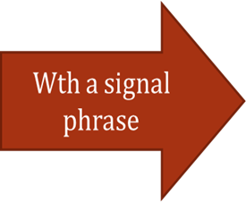
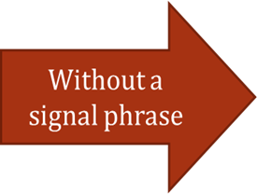
In-text Citations: A Work with Three or More authors
When citing a work with three authors or more, only use the first author's last name followed by "et al." in the signal phrase or in parentheses.

Slide 10
In-text Citations: A Work of Unknown Author
When citing a work of unknown author, use the source’s full title in the signal phrase and cite the first word of the title followed by the year of publication in parenthesis. Put titles of articles and chapters in quotation marks; italicize titles of books and reports.
According to “Indiana Joins Federal Accountability System” (2008), …
(“Indiana,” 2008)
Notes:
This slide explains and exemplifies the specific cases of in-text citations. It might be supplemented with “Author/Authors” section from OWL http://owl.english.purdue.edu/owl/resource/560/03/

Slide 11
In-text Citations: Organization
When citing an organization, mention the organization the first time when you cite the source in the signal phrase or the parenthetical citation.
If the organization has a well-known abbreviation, include the abbreviation in parenthesis the first time the source is cited and use only the abbreviation in later citations.
The data collected by the Food and Drug Administration (2008) confirmed that…
Food and Drug Administration (FDA) confirmed … FDA’s experts tested…
Notes:
This slide explains and exemplifies the specific cases of in-text citations. It might be supplemented with “Author/Authors” section from OWL http://owl.english.purdue.edu/owl/resource/560/03/

Slide 12
References Page
Center the title (References) at the top of the page and *BOLD* it.
Double-space reference entries
Flush left the first line of the entry and indent subsequent lines
Order entries alphabetically by the author’s surnames

Slide 13
References: Basics
Invert authors’ names
last name first followed by initials:
Alphabetize reference list entries by the last name of the first author of each work
Capitalize only the first letter of the first word of a title and subtitle, the first word after a colon or a dash in the title, and proper nouns:
Smith, J.Q.
Toward effective poster presentations: An annotated bibliography

Slide 14
References: Basic Format for Books
Author, A. A. (Year of publication). Title of work: Capital letter also for subtitle. Publisher.
Ex.:
Calfee, R. C., & Valencia, R. R. (1991). APA guide to preparing manuscripts for journal publication. American Psychological Association.

Slide 15
References: Article form an Online Periodical
With DOI Assigned
Author, A. A., & Author, B. B. (Date of publication). Title of article. Title of Journal, volume number, page range. doi:0000000/000000000000
Brownlie, D. (2007). Toward effective poster presentations: An annotated bibliography. European Journal of Marketing, 41, 1245-1283. 10.1108/03090560710821161

Slide 16
References: Article form an Online Periodical
With no DOI Assigned
Online scholarly journal articles without a DOI require the URL of the journal home page.
Author, A. A., & Author, B. B. (Date of publication). Title of article. Title of Journal, volume number. http://www.journalhomepage.com/full/url/
Kenneth, I. A. (2000). A Buddhist response to the nature of human rights. Journal of Buddhist Ethics, 8. http://www.cac.psu.edu/jbe/twocont.html

Slide 17
References: Online Encyclopedias and Dictionaries
Online Encyclopedias and Dictionaries
Often encyclopedias and dictionaries do not provide bylines (authors' names). When no byline is present, move the entry name to the front of the citation. Provide publication dates if present or specify (n.d.) if no date is present in the entry.
Feminism. (n.d.). In Encyclopædia Britannica online. http://www.britannica.com/EBchecked/topic/724633/feminism

Slide 18
References: Web Document, Web Page, or Report
You may have to hunt around to find the information; don't be lazy!
List as much of the following information as possible
Author, A. A., & Author, B. B. (Date of publication). Title of document. http://Web address
Angeli, E., Wagner, J., Lawrick, E., Moore, K., Anderson, M., Soderland, L., & Brizee, A. (2010, May 5). General format. http://owl.english.purdue.edu/owl/resource/560/01/

